Slide 1
Computer Science 1
Basics in Python

Slide 2

Your First Program
Open the Thonny Python Editor
Create a new module.
A Python file is called a module.
Click File then New
You can also click this “paper” icon to make a new python file

Slide 3
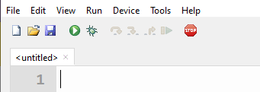
Your First Program
Your new modules is untitled because it is not saved yet.
We will have lots of modules so we should keep our work organized in directories (also called folders).
You can also click on File, then Save or Save As
Click the blue “disk” icon to save.

Slide 4
Your First Program
Create a directory called Python-Projects in the location you prefer (either a flash drive, cloud drive, or a Documents directory on your computer)
Inside this directory, create another directory called Python-Level1.
Inside this directory make one more directory called Lesson-01-Basics
This directory will store all your example programs from this lesson. Later we will make entire directories for a single project.
Save your module in Python-Projects/Python-Level1/Lesson-01-Basics as first_program.py (do not type the .py, Thonny will add this extension automatically)

Slide 5
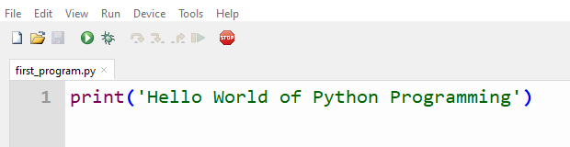
Your First Program
Type the following code exactly as it shows.

Slide 6
Your First Program
Run the module
Or you can select “Run current script” from Run menu. (or press F5 key)
Click Green Arrow to run.

Slide 7
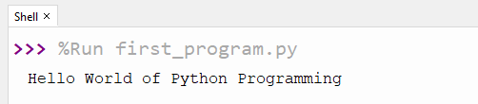
Your First Program
If it was not there, the Shell window should appear in your Thonny application. You should see the following if you typed the program correctly.

Slide 8

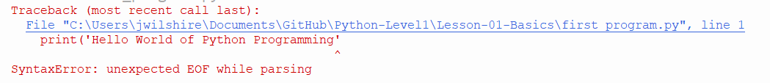
Debugging your Program
Being humans – we sometimes make mistakes.
Python helps you to debug your code.
The error appears in the shell. There may be more than one, check the last one first. Look at the location of the ^ to find the error location. You can also click the blue link to highlight the line of code with an error.
Missing closing )

